Slide 1
FORCE SENSING IN MEDICAL ROBOTICS
PRESENTED BY:
MOHSIN MEHMOOD & Hafeez Shittu

Slide 2
BACKGROUND
Early stages
History of Mechatronics in medical sciences
Various discoveries
Robots
Examples (Zeus, Da Vinci model)
7 degrees of freedom

Slide 3
FORCE SENSING TECHNIQUES IN MEDICAL ROBOTICS
Most Common and recent
Application
Sensors
Elastic properties

Slide 4
EXAMPLES OF DISPLACEMENT SENSORS
Digital encoder
Potentiometer
Linear variable differential transformers
Fiber-based sensor

Slide 5
WORKING PRINCIPLE
Mechanical tissue properties
Light detection
Electrical signal
Amplification
Digitization

Slide 6
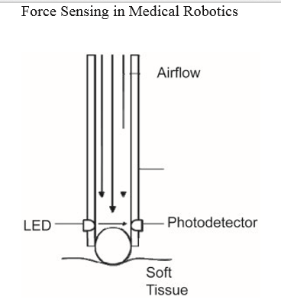
RECENT SENSOR

Slide 7
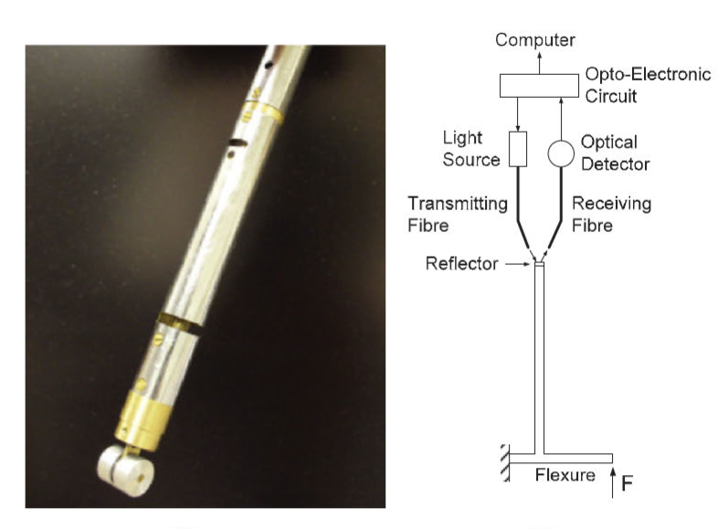
SOLVING ISSUES
Miniaturization
Optical fibers
Modulator
Reflector

Slide 8
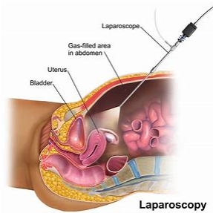
HEPTIC FEEDBACK DURING ROBOTIC SURGERY
Cutaneous
Kinesthetic
Da Vinci surgical system
MIS and miniature force/torque sensor
Force sensor
Evaluating sensor
Cons

Slide 9
SOFT TISSUE DIAGNOSIS THROUGH TISSUE MECHANICAL PROPERTY
Biometric of soft-tissue
Viscoelastic
Stress-strain relationship
Time and strain rate dependency

Slide 10


MODELLING OF A NON-LINEAR STRESS-STRAIN FUNCTION
Hyper elastic theory
Stress-strain in Tissue mechanics
Fung function

Slide 11
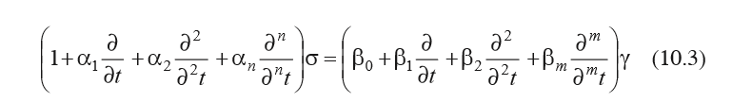
MODELLING OF LINEAR VISCOELASTICITY
Super-position Principle
Stress proportionality
General differential equation

Slide 12
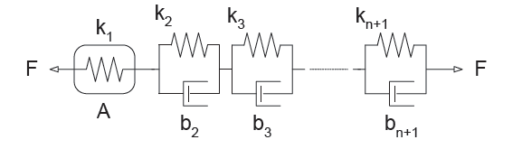
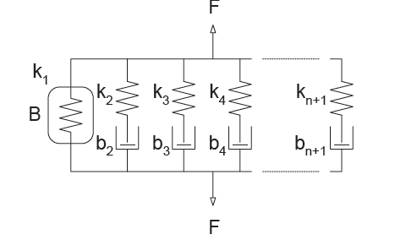
BASIC MODELS
Hooke’s law
Vigot
Maxwell
Kelvin
Rheological theory

Slide 13
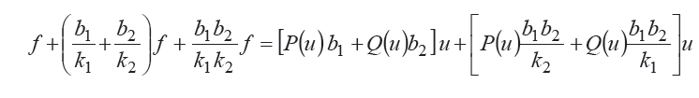
MODELLING OF NON-LINEAR VISCOELASTICITY
Non-linear function addition
Deformation

Slide 14
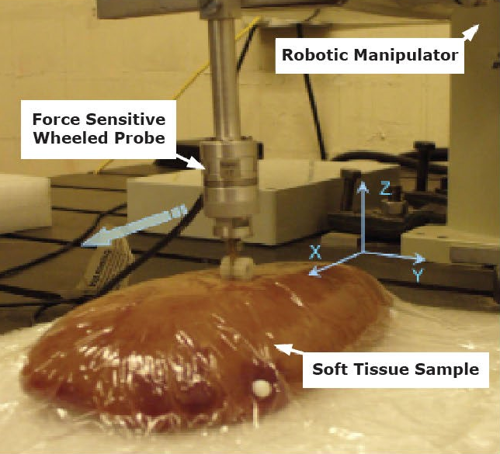
SOFT TISSUE DIAGNOSIS THROUGH TISSUE-INSTRUMENT INTERACTION
Tradition in Medicine
Empirical formulas
Cons
Rolling sensor
Continuous result

Slide 15
QUESTIONS?

